Slide 1
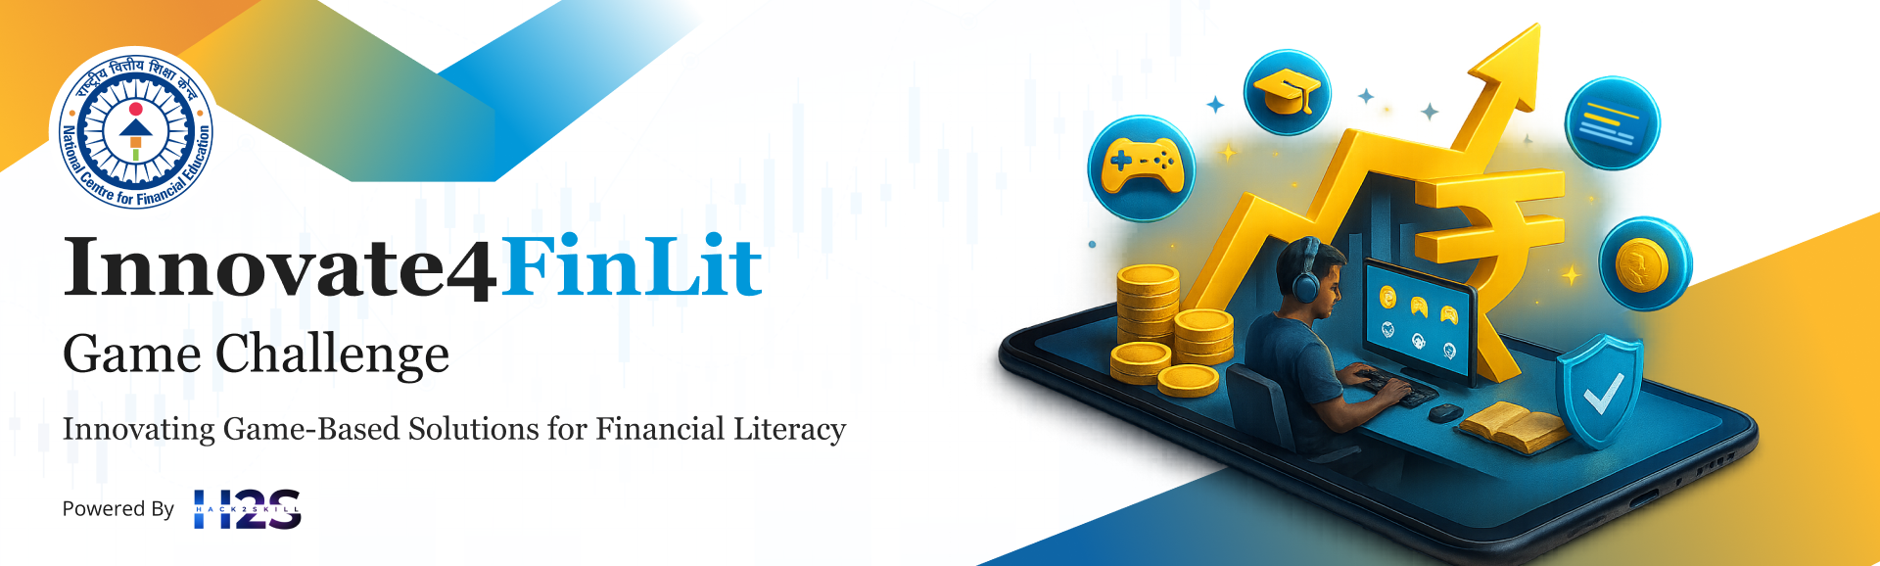
Team Name :
Status@200
Team Leader Name :
Tarun Bommali
The lack of practical, accessible, and behavior-driven financial education—especially in low-connectivity environments—creates a need for a scalable, offline-first gamified platform that enables users to learn financial decision-making through real-world simulations.
Problem Statement :

Slide 2

Brief about the Idea:
The idea is to develop a scalable, offline-first gamified financial literacy platform that helps users learn money management through real-world financial simulations rather than theoretical lessons. The platform allows users to manage a virtual income, make financial decisions related to budgeting, savings, credit, insurance, investments, and digital safety, and observe the short-term and long-term consequences of those decisions.
Designed as a mobile-first Progressive Web App, the solution works effectively in low-internet and rural environments, with offline gameplay and secure data synchronization when connectivity is available. The system follows a modular backend architecture, enabling scalability across multiple user groups such as students, young adults, women, and farmers.
By combining behavior-driven learning, gamification, and scalable software engineering, the platform enables users to build practical financial skills, improve decision-making behavior, and become financially empowered in real life.

Slide 3
Opportunity should be able to explain the following:
1. How is it different from existing solutions?
Most existing financial literacy platforms rely on theory-based content, videos, or quizzes that explain concepts but do not prepare users for real-world financial decisions. These solutions also depend heavily on
continuous internet access, making them unsuitable for rural and low-bandwidth environments. Our solution is different because it uses real-life financial simulations and decision-driven gameplay instead of static learning. It is designed as an offline-first platform, allowing users to learn anytime, anywhere,
without being dependent on internet connectivity.
2. How will it solve the problem?
The platform solves the problem by enabling users to learn by doing. Users manage a virtual financial life,
make decisions related to budgeting, savings, credit, insurance, investments, and digital safety, and
immediately see the consequences of their choices.This behaviour-driven approach helps users understand
financial trade-offs, avoid common mistakes, and gradually develop better financial habits. Offline support
ensures accessibility across diverse Indian conditions, while a scalable backend allows the system to grow
with increasing users and scenarios.
3. USP (Unique Selling Proposition) of the Solution A behaviour-driven, offline-first gamified platform that teaches financial literacy through real-world decision simulations, making learning practical, accessible, and scalable.

Slide 4
List of features offered by the solution
✔ Offline-first financial simulations ✔ Decision-based learning with real consequences ✔ Gamified progress tracking (levels, scores, rewards) ✔ Fraud awareness & digital financial safety simulations ✔ Multi-user group support (Student, Young Adult, Women, Farmer) ✔ Scalable and extensible backend architecture ✔ Low-bandwidth & rural-friendly design ✔ Real-time feedback on financial decisions ✔ Scenario-based learning instead of quizzes ✔ Long-term financial health scoring ✔ Secure user authentication & data protection
✔ Multilingual support ✔ Future-ready AI/ML-based personalization (optional)

Slide 5
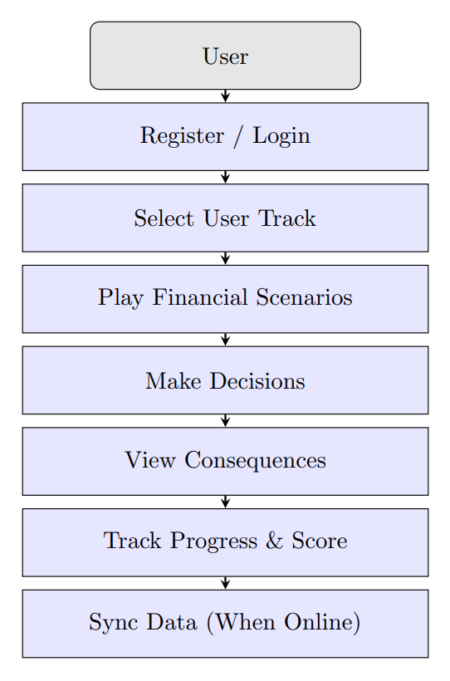
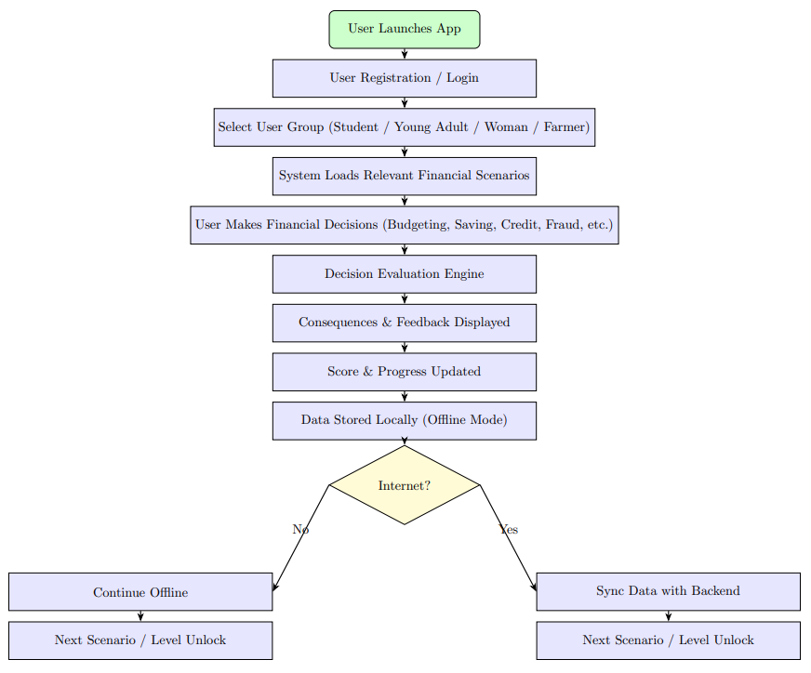
Process flow diagram or Use-case diagram

Slide 6
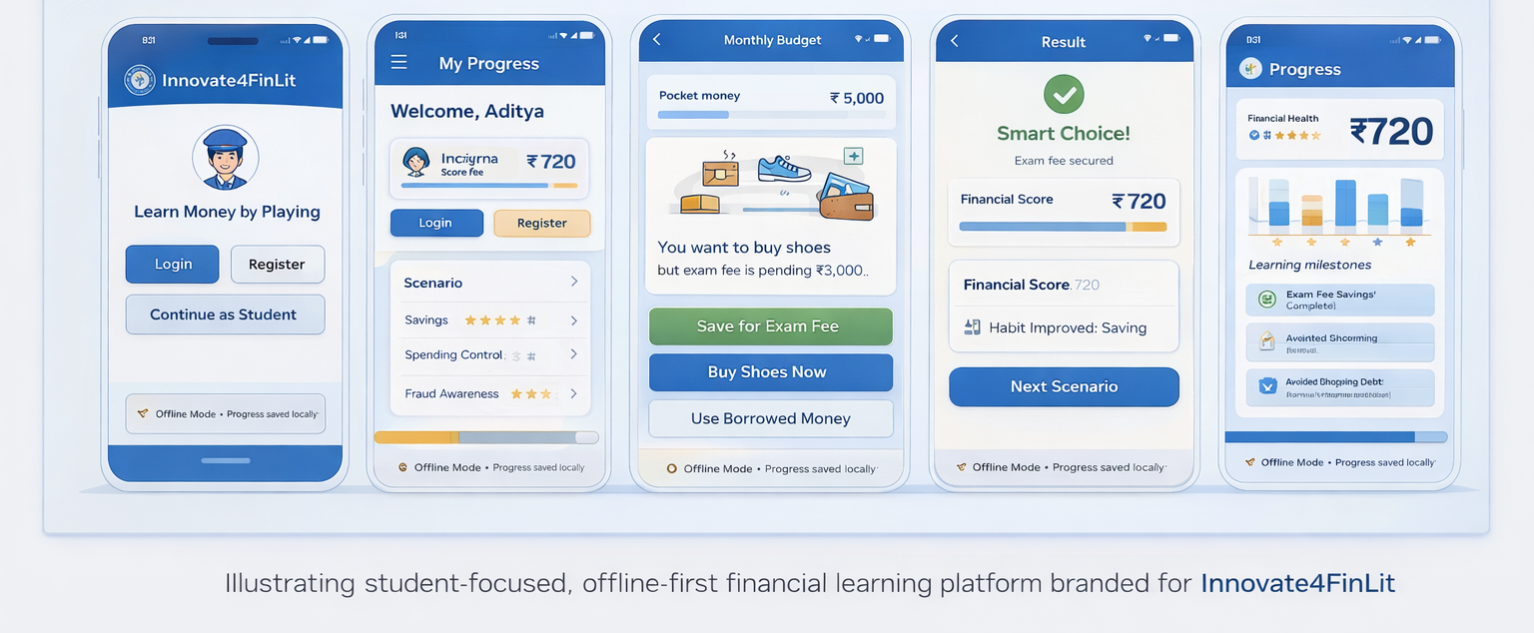
Wireframes/Mock diagrams of the proposed solution

Slide 7
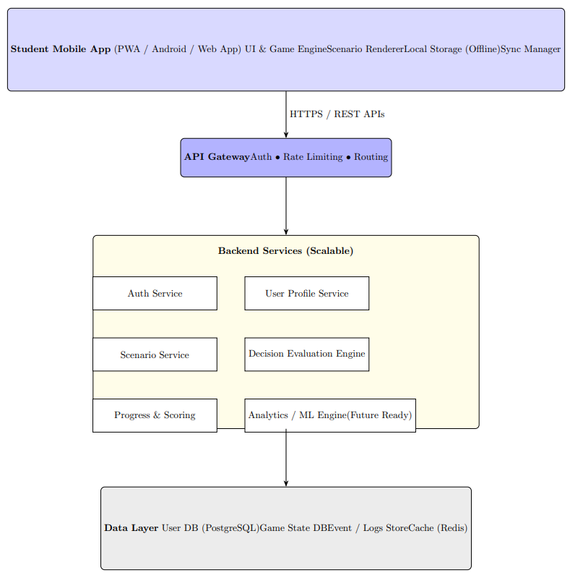
Architecture diagram of the proposed solution

Slide 8
Technologies to be used in the solution:
Frontend / Client
React.js,Progressive Web App (PWA),HTML5, CSS3, JavaScript
Service Workers, IndexedDB (Offline Storage)
Backend / APIs
Node.js,Express.js,RESTful APIs, JWT Authentication
Database & Storage
PostgreSQL, MongoDB,Redis (Caching)
Machine Learning & Analytics (Optional / Future)
Python, Pandas, NumPy,Scikit-learn, Mlflow,FastAPI
Infrastructure & DevOps
Docker,AWS EC2,AWS S3,AWS RDS,Git, GitHub
✔

Slide 9


